Slide 1
Space Invaders – Lite Edition
Henry Bishop, Hasnat Rubaiyat, Bradley Hallier

Slide 2
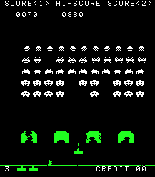
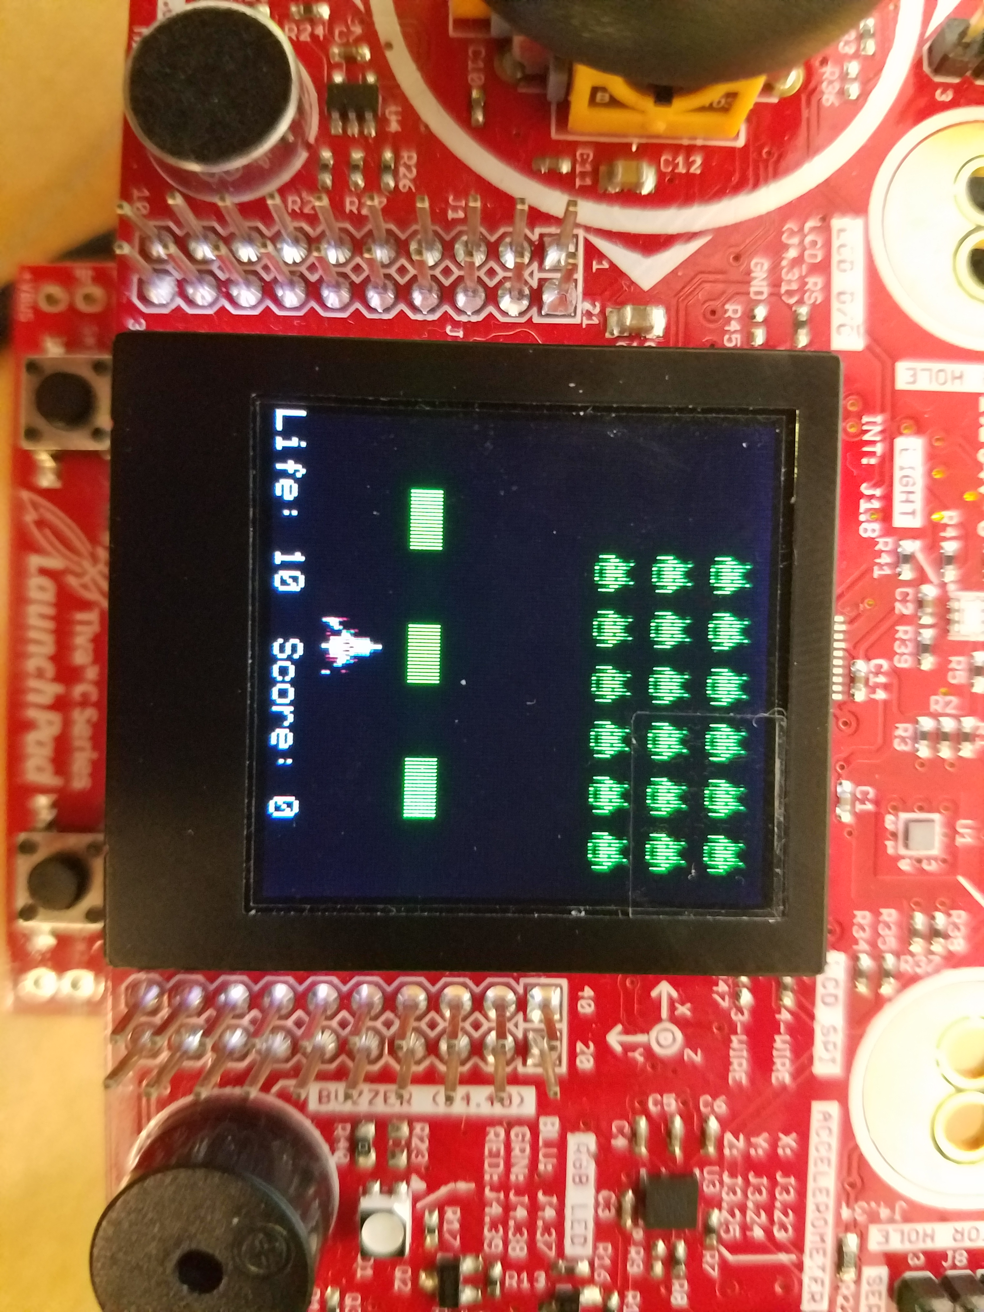
Our Idea
Game based off of popular “Space Invaders” arcade game
Use accelerometer to control player spaceship
Aliens gradually move towards player
Player uses Button 2 to shoot at aliens
Aliens shoot back
Shield protects spaceship from aliens

Slide 3
New Files for Space Invaders
Three new files were used to add the required functionality to the game:
Aliens.c
Describes alien behavior and objects
bullet.c
Describes bullet behavior and collision algorithm
Game.c
Describes player and shield

Slide 4
Data Flow Diagram

Slide 5
Game Implementation
Players, shields, and aliens all have separate objects giving them qualities
alienThread: calls functions for defined alien movement based on OS_Time
bulletThread: handles bullet movement based on OS_Time and handles resetting bullets
collisionThread: handles all collision events with player, shields, and aliens using general collision alg
Display: handles all display events based on global object positions

Slide 6
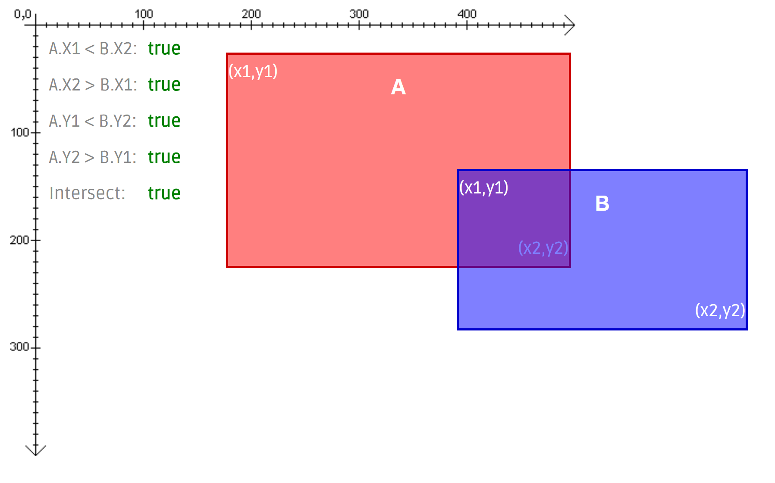
Collision Behavior
Defined as the intersection of two rectangular blocks of arbitrary size and position
Returns 1 or 0 depending on whether or not two particular objects are intersecting
Calculation based on relative positioning's of end points
https://silentmatt.com/rectangle-intersection/

Slide 7
Accelerometer
Utilizes X-Axis on accelerometer to move spaceship
Consisted of several minor changes to joystick.c
Utilized Sample Sequencer 2 (SS2) to recover data from Port D Pin 0
Took input and scaled value inside of Update_Position function to move player spaceship at reasonable speed

Slide 8
Group Member Responsibility
Henry
Accelerometer functionality
Player/shield functionality
Collision algorithm/thread
Integration
Hasnat
Display thread
Alien functionality
Bullet and collision threads
Integration
Bradley
Code integration
Thread Optimization
End game screen
Collision thread

Slide 9
Insights
GitHub isn’t very helpful unless tasks are independent, which mostly wasn’t the case in this project
It is important to create well thought out object structures and threads ahead of time to ensure that independent work doesn’t clash due to lack of standardization
Code reuse from the block game was very helpful and significantly reduced the time it would have taken to implement from scratch

Slide 10
Demo

Slide 11
Questions

